Slide 1


Banking Dataset Marketing Targets
Module 6 Project ALY6000 Introduction to Analytics [CRN 22279]
Presented by Poonam Dighe [NUID 002965616]
Professor Dr. Mohammad Shafiqul Islam

Slide 2
Table of Contents
DATA DICTIONARY - Bank client data
KEY BUSINESS QUESTIONS
Data Cleansing
Bar plots & summary of graphs
Data Analysis
References

Slide 3
DATA DICTIONARY -Bank client data
1. age :(numeric) Age of the client
2. job : type of job (categorical:"admin.“,"unknown","unemployed","management","housemaid","entrepreneur","student", "blue-collar","self-employed","retired","technician","services")
3. marital : marital status (categorical: "married","divorced","single"; note: "divorced" means divorced or widowed)
4. education (categorical: "unknown","secondary","primary","tertiary")
5. default: has credit in default? (binary: "yes","no")
6. balance: average yearly balance, in euros (numeric)
7. housing: has housing loan? (binary: "yes","no")
8. loan: has personal loan? (binary: "yes","no")
9. contact: contact communication type (categorical: "unknown","telephone","cellular")
10. day: last contact day of the month (numeric)
11. month: last contact month of year
12. duration: last contact duration, in seconds (numeric)
13. campaign: number of contacts performed during this campaign and for this client (numeric)
14. pdays: number of days that passed by after the client was last contacted from a previous campaign (numeric, -1 means client was not previously contacted)
15. previous: number of contacts performed before this campaign and for this client (numeric)
16. poutcome: outcome of the previous marketing campaign (categorical: "unknown","other","failure","success")
Output variable (desired target): 17 - y - has the client subscribed a term deposit? (binary: "yes","no")

Slide 4
KEY BUSINESS QUESTIONS
Based on a comprehensive examination of the dataset, the following are some sample questions that can be addressed
What are the major factors that influence a customer's decision to convert his balance into a term deposit subscription?
What encourages the client to take out a loan?
How is term deposit subscription analysis carried out?
What is the prevalence of term deposit subscription and loan?
Do working and nonworking professionals face the same risk when taking out a term deposit subscription?
Which type of loan is more risky, and which is more advantageous?

Slide 5
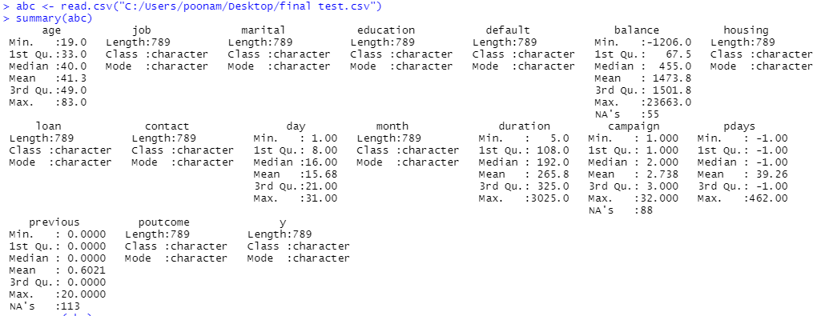
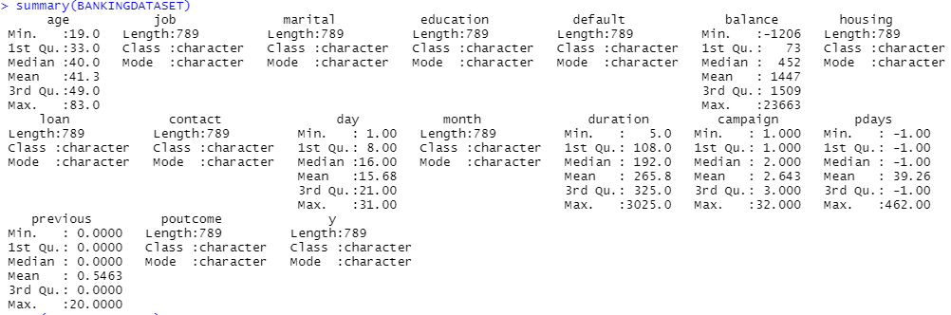
DATA CLEANSING
The Summary(BANKINGDATASET) function provides detailed information about columns that have NAs, mean or mode, minimum and maximum values.
When we apply the structure
function to our dataset, we learn
that we have 789 observations
and 17 variables, each with their
own data type.
There are null values in the dataset(abc) in 3 columns balance, campaign and previous that has been removed while cleansing the data. The new dataset (BANKINGDATASET) does not contain any null values.

Slide 6
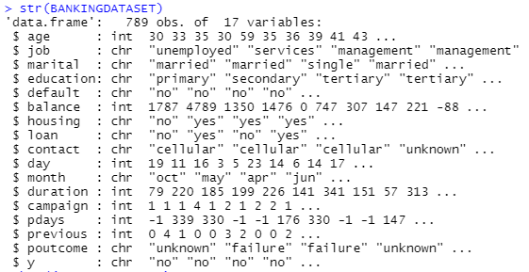
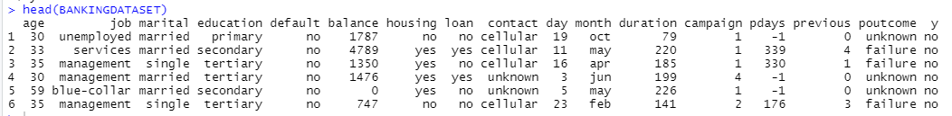
DATA ANALYSIS
The first six observations of each column are displayed in the head (BANKINGDATASET).
After applying str function we learn about the total number of observations along with the number of variables. Data types are also displayed in the information.

Slide 7
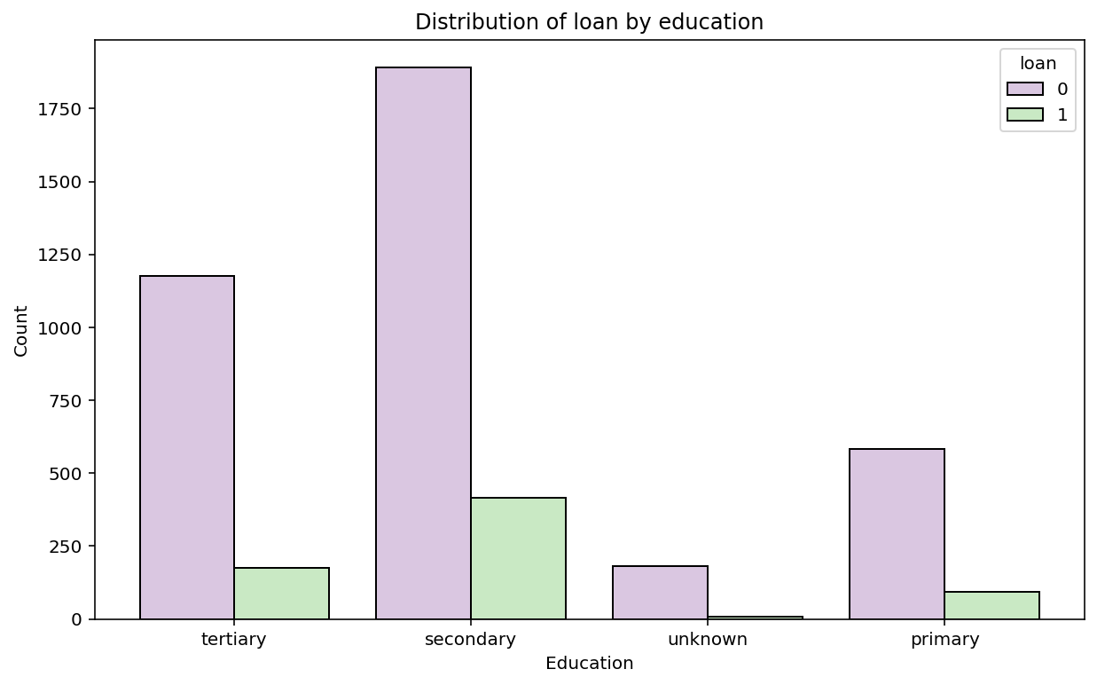
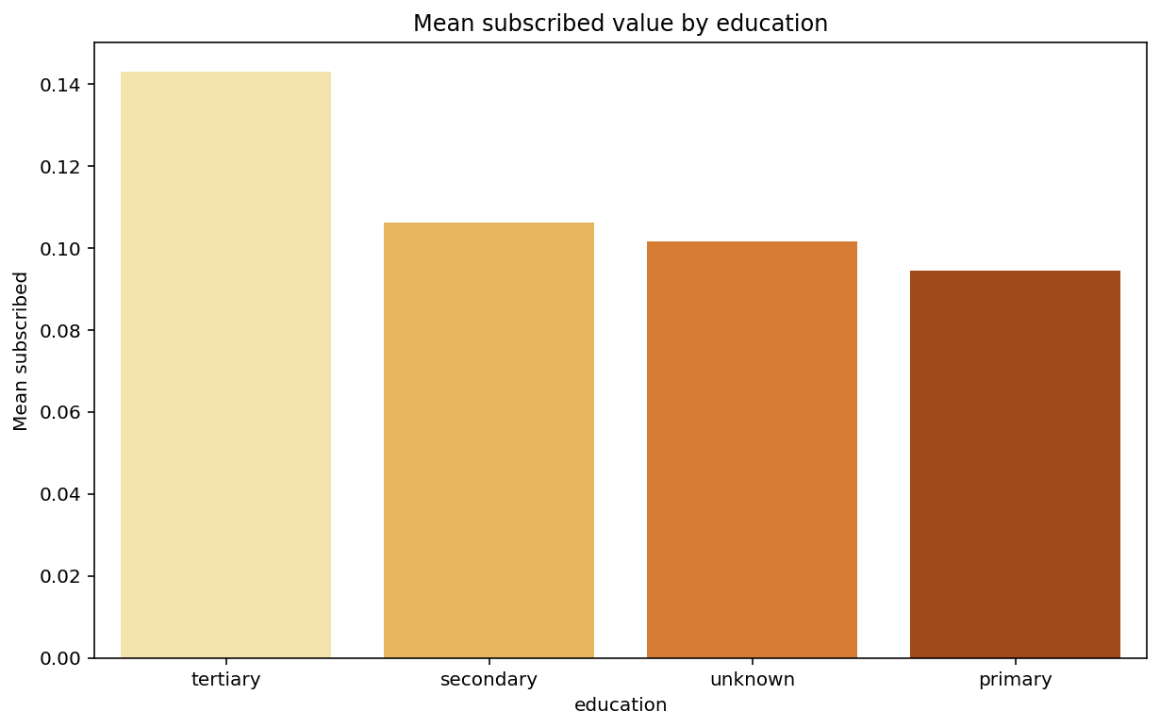
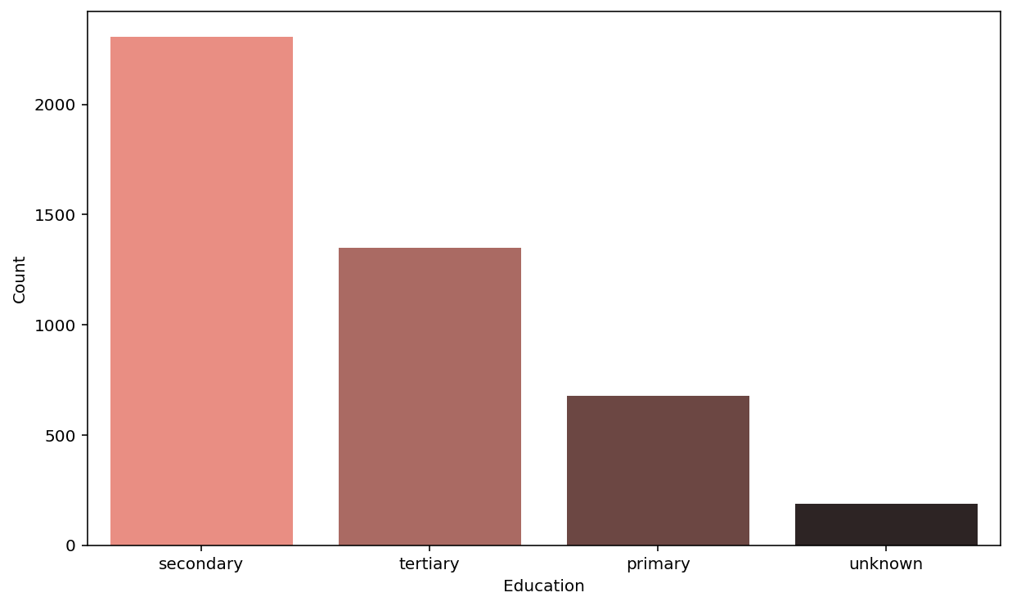
DATA VISUALIZATION & ANALYSIS
DATA ANALYSIS
The bar graph shows that the majority of clients who have taken loans and those who have not taken loans are in the secondary education category.
Tertiary education has the second highest number of people who have not taken out a loan, followed by primary education.
As per the bar graph, majority of clients have completed their secondary education.

Slide 8
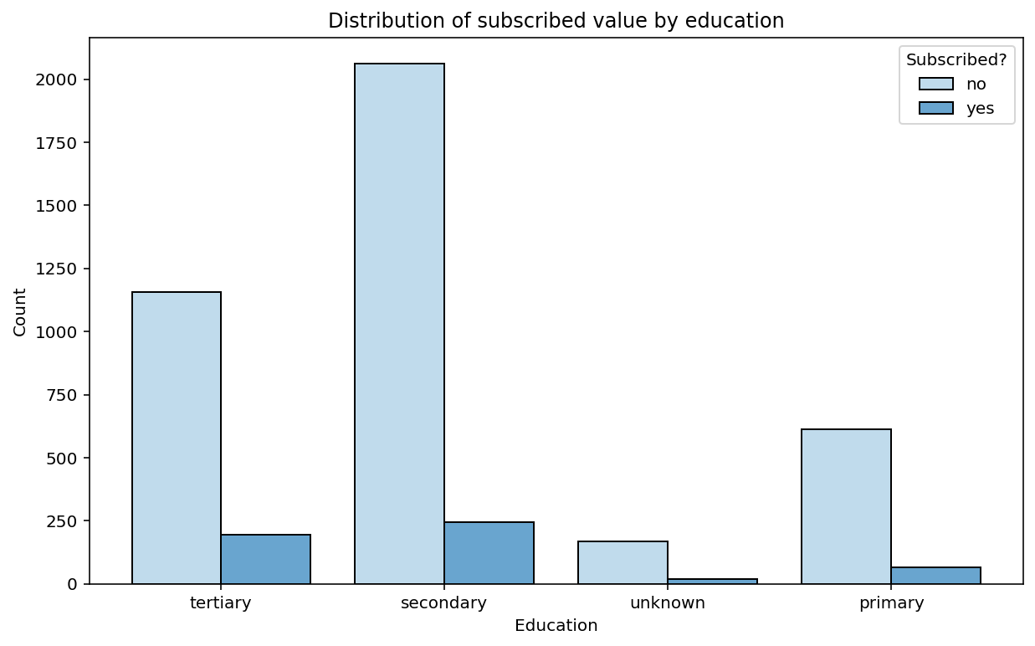
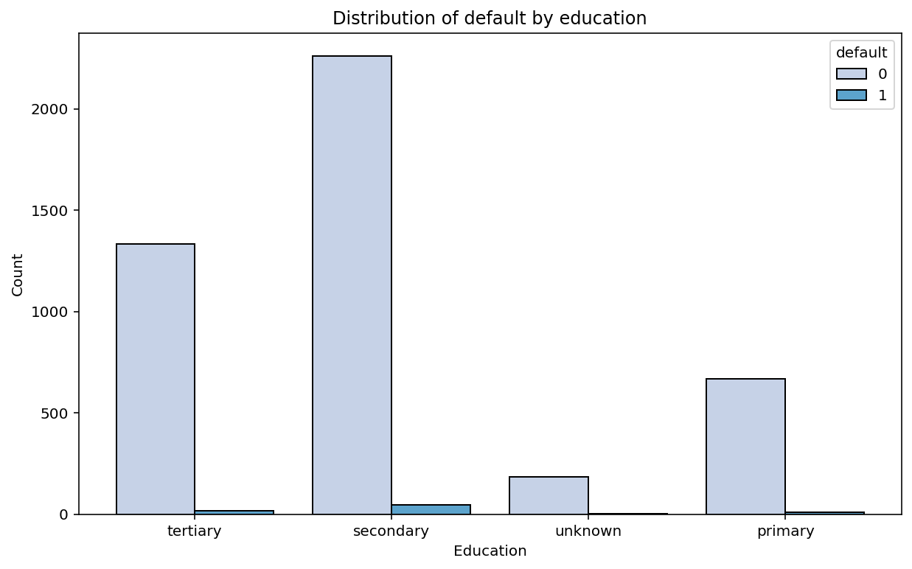
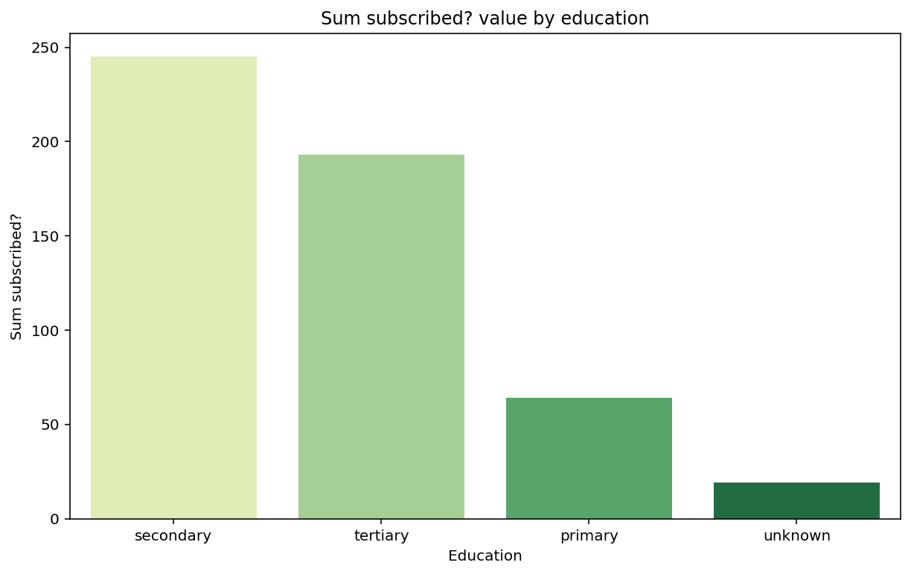
The bar graph depicts that average number of clients has not gone for term deposit subscription. who is more educated (tertiary education)
Majority of Clients who not gone for term deposit subscription are having secondary education.
Very few people have decided to go for term deposit subscription from basic education category (unknown)

Slide 9
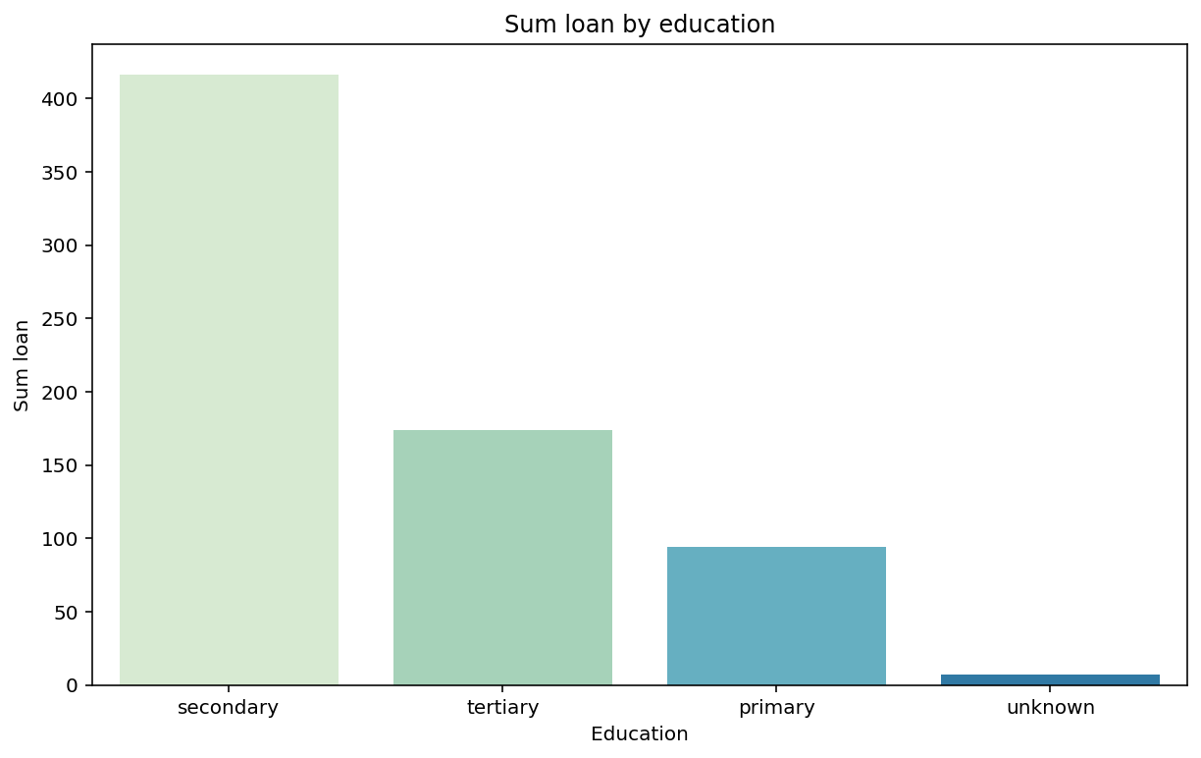
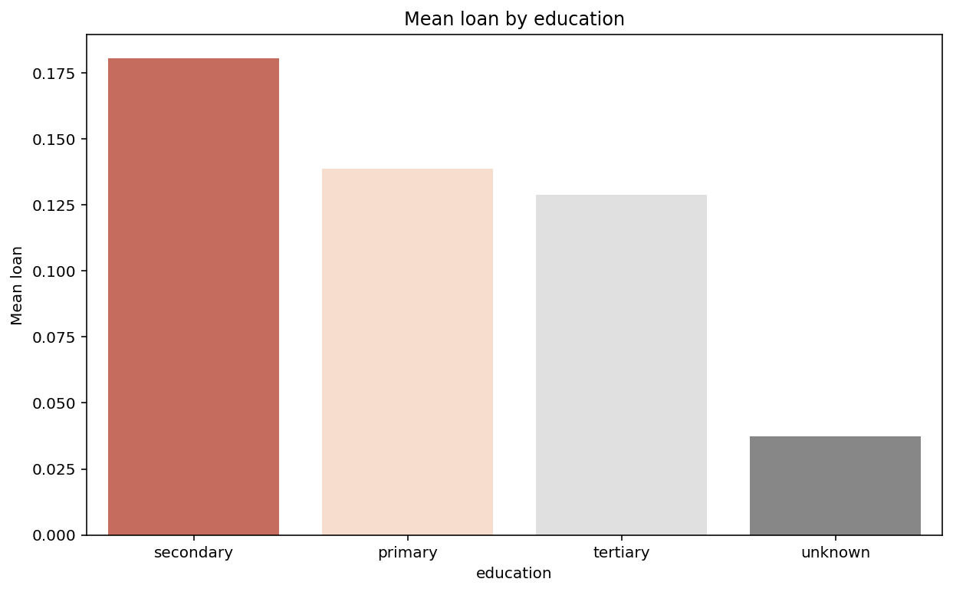
DATA ANALYSIS
The vast majority of people with a secondary education have borrowed money.
People with primary and secondary education make up the majority of those who decide to take out a loan.
Few people who have not even completed primary school have applied for a loan.

Slide 10
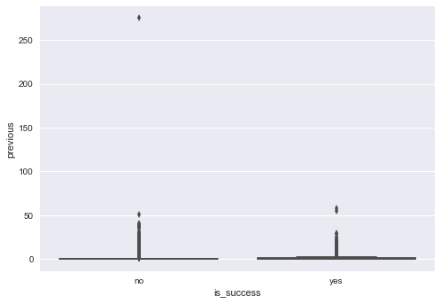
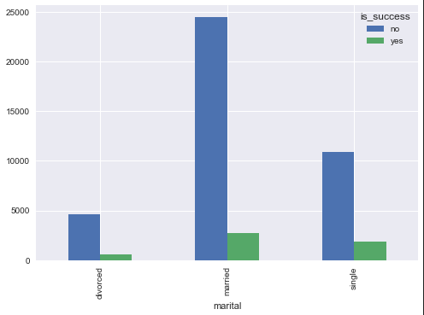
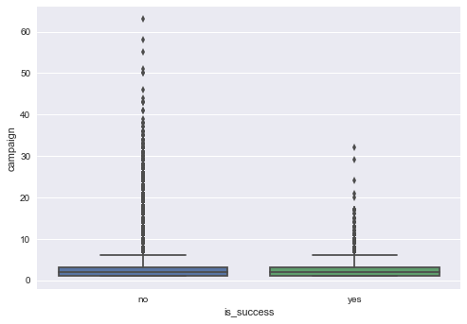
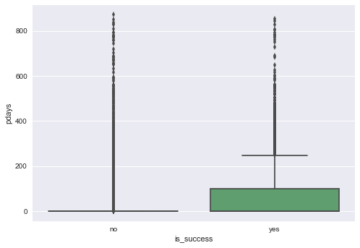

Slide 11
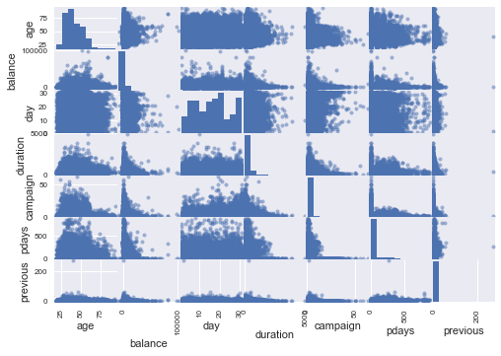
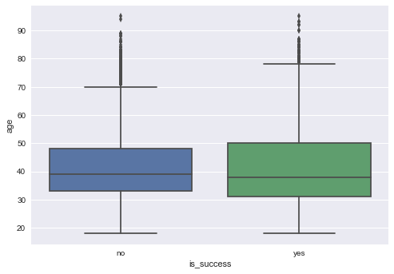
From the above result one can see that some variables ('balance', 'duration', 'campaign', 'pdays', 'previous’) has outliers. That can also visualize through graph further.
Scatter plot matrix showing that there is no strong relationship between these indepedent variables
Lets analyze all Independent Numerical variables
against Target variable 'is_success' by plotting Boxplot.We can easily find outliers through Boxplot.
Analysis of Indepedent Numerical Variables.
I did analysis of each individual variable and checking if there is any outlier values present.
I choose a range based on Maximum and Minimum value for each variable selected by observing Boxplot of corresponding variable.

Slide 12
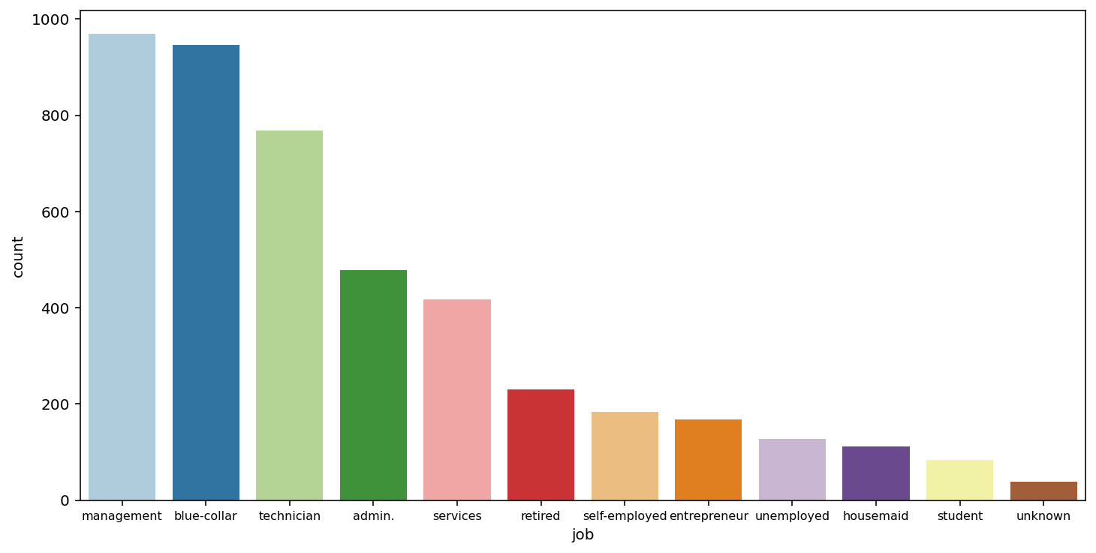
The graph depicts the total percentage of clients who have signed up for a term deposit depending on their job profile.
92.71 percent of blue collar job profile clients, which is the highest, have not subscribed to term deposit, while 7.29 percent, which is the lowest, have.
On average, students and retirees have shown great level of interest in term deposit subscriptions, with 22.62 percent and 23.48 percent, respectively.
Term deposits are not used by 76.52 percent of retired people, the lowest percentage of all.
Even if they are not well paid, retirees, unemployed, students, and housemaids are interested in term deposit subscription.
Admin, blue-collar, entrepreneur, management, self-employment, services, despite the fact that such a group earns a lot of money, they are not interested in signing up for term deposits.

Slide 13
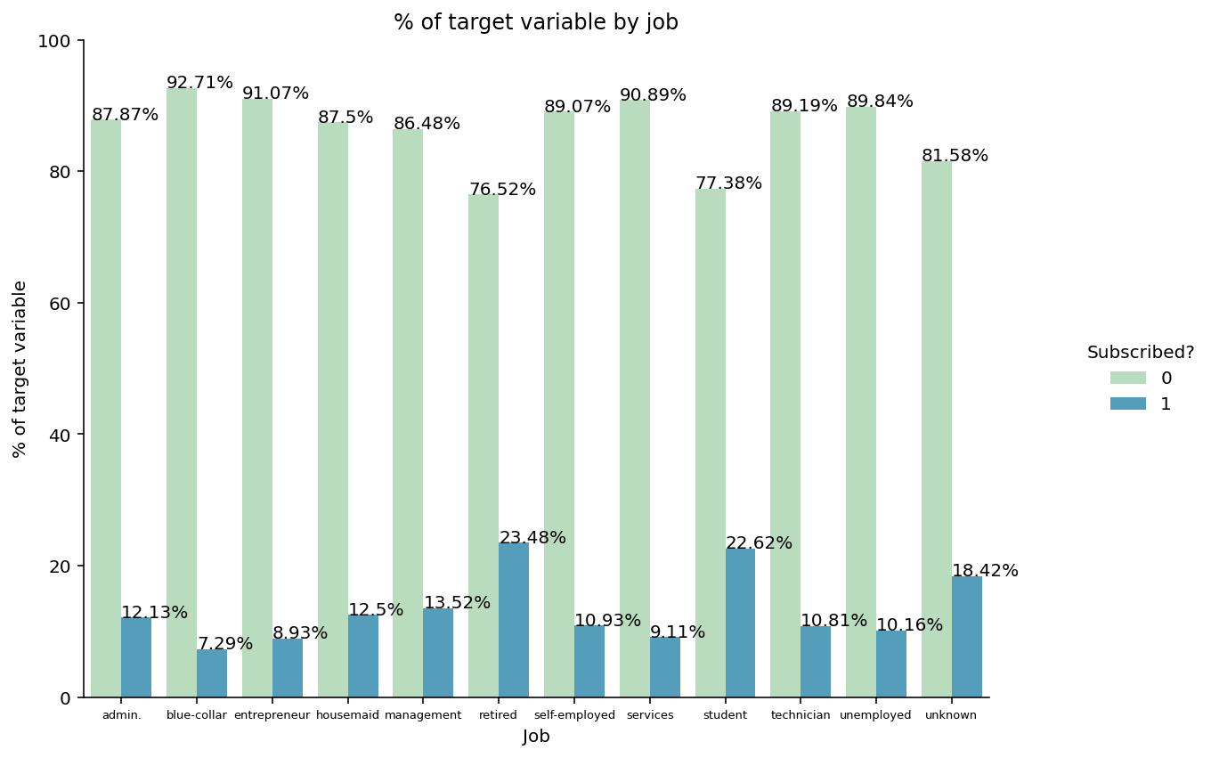
Overall, the bar graph depicts the total percentage of clients who have and have not subscribed to term deposits.
Data is classified based on their educational background.

Slide 14
References
Data Analytics DataMentor, Nov 2017, https://www.researchgate.net/publication/264555968_Big_Data_Analytics_A_Literature_Review_Paper Accessed 19 Feb. 2022.
Bar plot, https://www.stafficial.com/blog/career-path-for-etl-developer-jobs-salaries/
Accessed 19 Feb. 2022
Future prospects for banking datasets ,1 feb 2018, https://cyberchasse.com/exciting-job-opportunities-and-future-prospects-for-etl-developers/ Accessed 18 Feb. 2022
Government of Canada, Statistics Canada. Statistics: Power from Data! Analytical Graphing: Cumulative Frequency, Dec 2020, https://www150.statcan.gc.ca/n1/edu/power-pouvoir/ch10/5214862-eng.htm Accessed 19 Feb. 2022

Slide 15
THANK YOU
For any queries, please contact me at
dighe.po@northeastern.edu

